Slide 1

President’s Reception and Awards Recognition

Slide 2
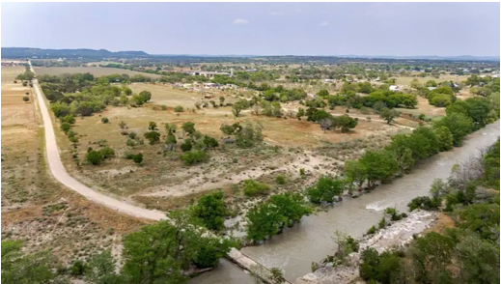
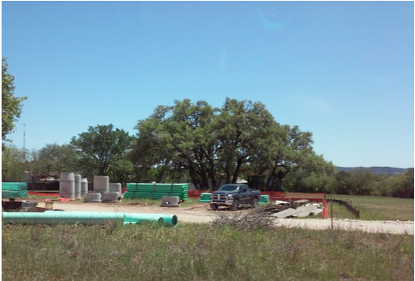
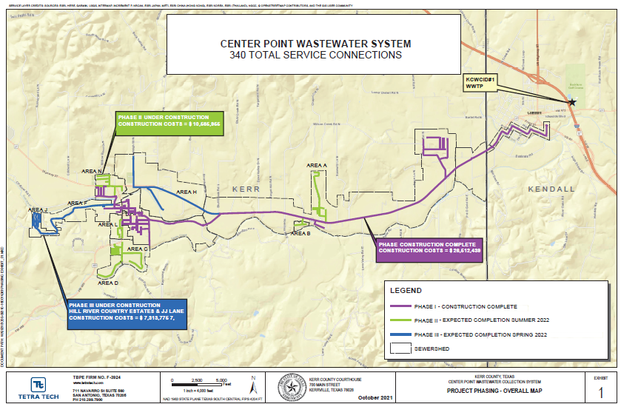
2024 Sterling Achievement Award – Community Development
State of Texas – Colonia Economically Distressed Areas Program - Center Point

Slide 3








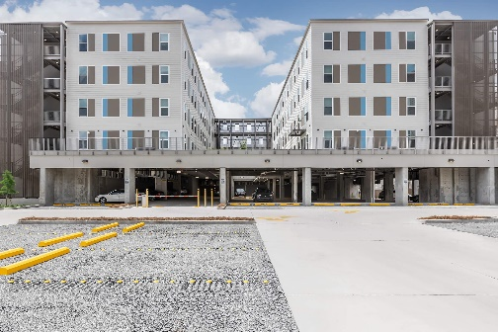
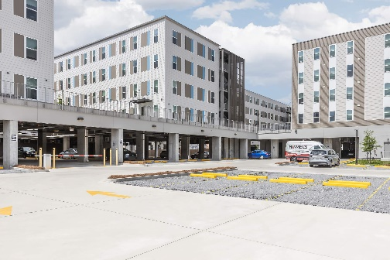
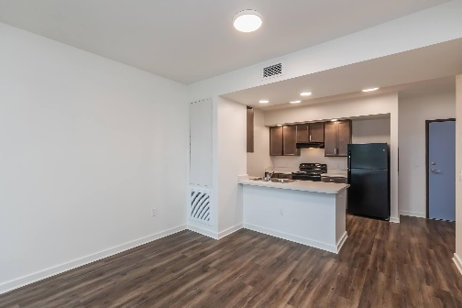

2024 Sterling Achievement Award – Disaster Recovery
State of Louisiana –H3C Health + Housing

Slide 4

2024 Sterling Achievement Award – Homelessness
State of Alaska – Dynamic Capacity Modeling

Slide 5
2024 Sterling Achievement Award – Housing
State of Pennsylvania - Conestoga North

Slide 6
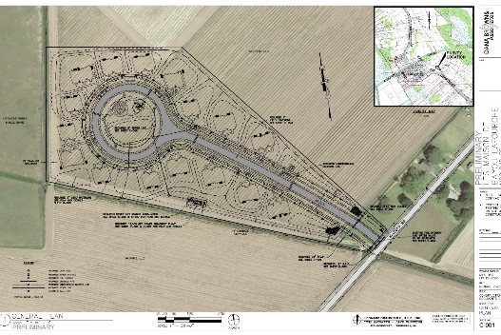
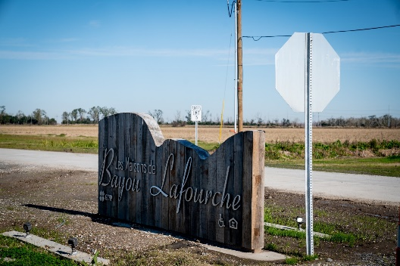
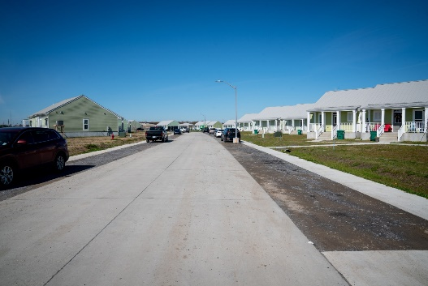
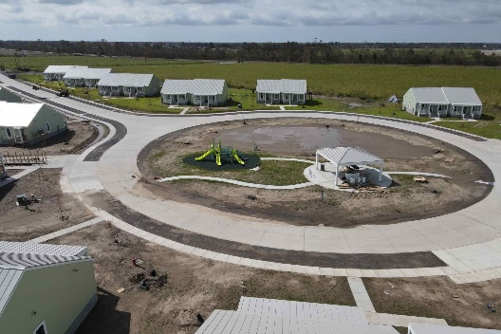
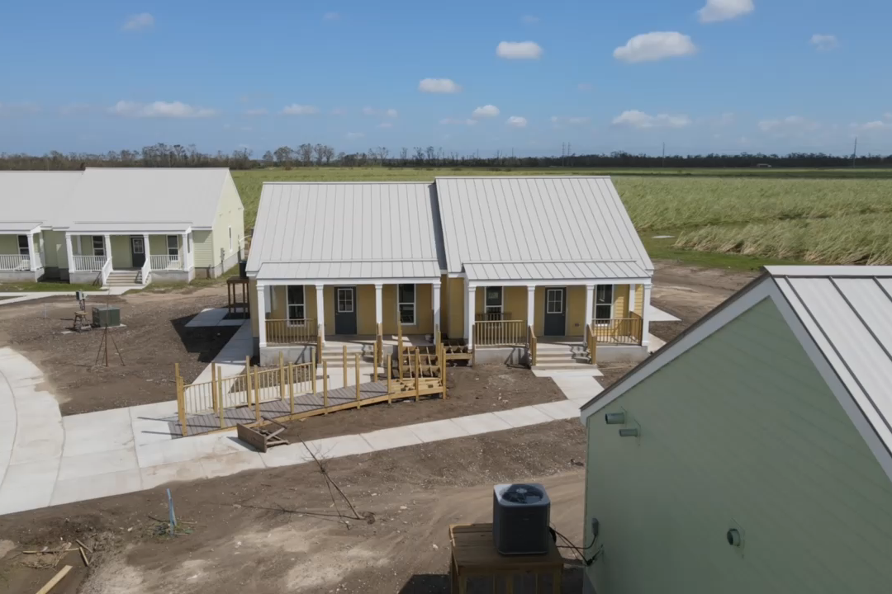
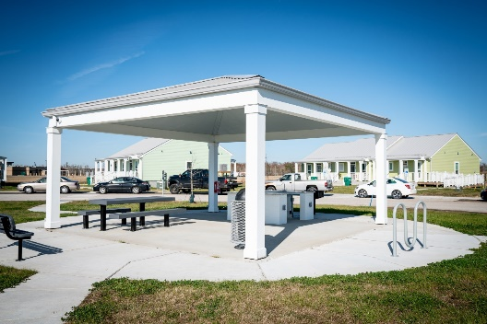
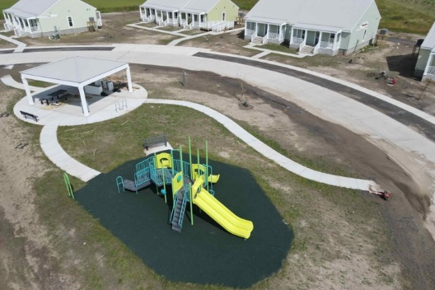
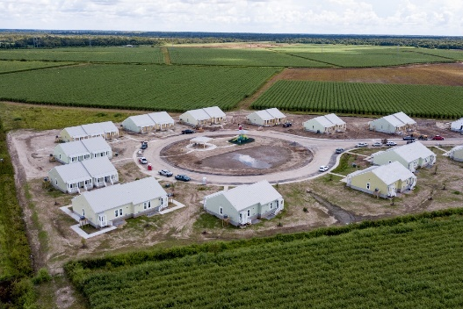
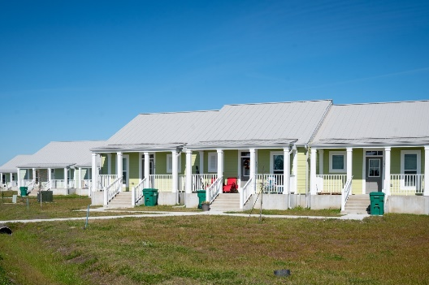
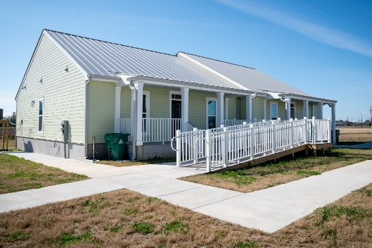

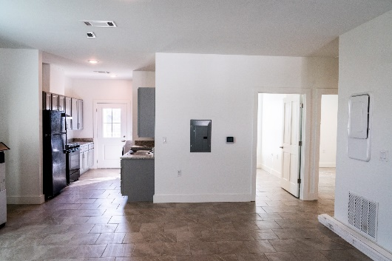
2024 Presidential Award for Innovation
State of Louisiana – Les Maisons de Bayou Lafourche

Slide 7

2024 JAMES REEVES MEMBER CONTRIBUTION AWARD
Texas –Heather Lagrone

