Slide 1
Technical Assistance (TA)
Presenter:
Amanda S. Clark

Slide 2
What is Technical Assistance (TA)?
A TA event is a formal conference, meeting, webinar or teleconference conducted to give the grantee the information, guidance and/or tools necessary to carry out disaster recovery projects.
The event is formal in that it is scheduled in advance, with the appropriate meeting invites, giving the TA recipient ample time to suggest an alternative time or agree to the originally proposed time.
The event is given either by OCD/DRU staff or contractors, to grantees in areas to be monitored by HUD.
Notes:
What is Technical Assistance (TA)?

Slide 3
Events Eligible for Quarterly Reporting
Allowable Costs – Administrative Costs allowable under applicable OMB Circulars, HUD approved Action Plans, Action Plan Amendments, State Guidelines, etc.
Eligible CDBG Activity – Activities eligible under 24 CFR 570.
Environmental Reviews – Activities comply with applicable environmental reviews.
Financial Management – Activities comply with OMB circulars regarding financial procedures and support documentation.
Davis Bacon – Labor.
National Objective – Activities comply with HUD Disaster Recovery national objective determination.
Uniform Relocation and Acquisition.
Duplication of Benefits – Stafford Act’s prohibition of duplication of benefits for disaster program beneficiaries.
Related to Disaster - Disaster Recovery CDBG requires that grantees document the way assistance addresses the effects of the disaster identified in each appropriation.

Slide 4
Event start date.
Event end date.
If it was an On-Site or Remote event.
Event organizer(s)/presenter(s) – Orleans Parish, HGA, OCD Staff, Compass, etc.
Date notice of event was sent to participants.
Brief description of the event.
Which of the 9 TA event types above describe(s) your TA event.
Program(s)/project(s) discussed during TA event (Please be specific as possible with activity/project numbers).
What is required for each TA entry?

Slide 5
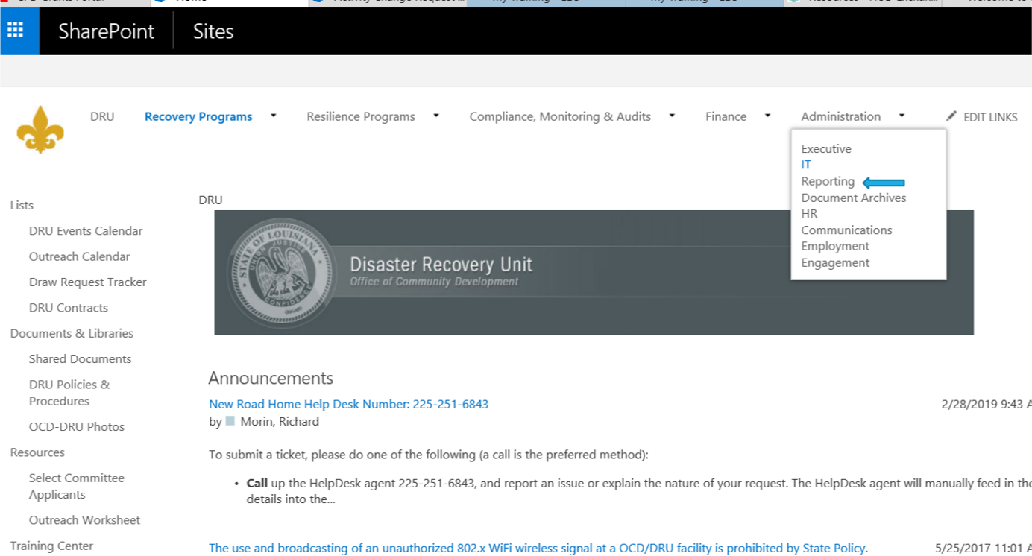
Go to the SharePoint website https://roadhome.la.gov/

Slide 6
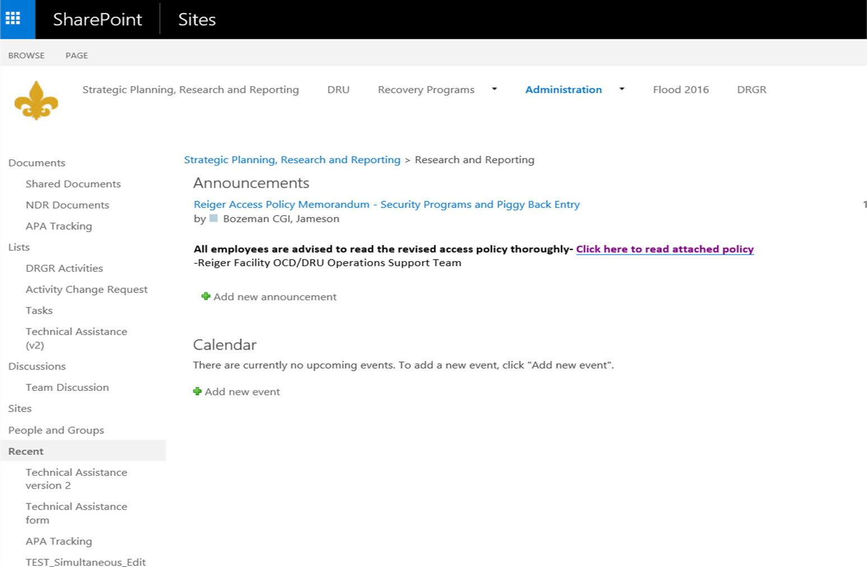

Slide 8
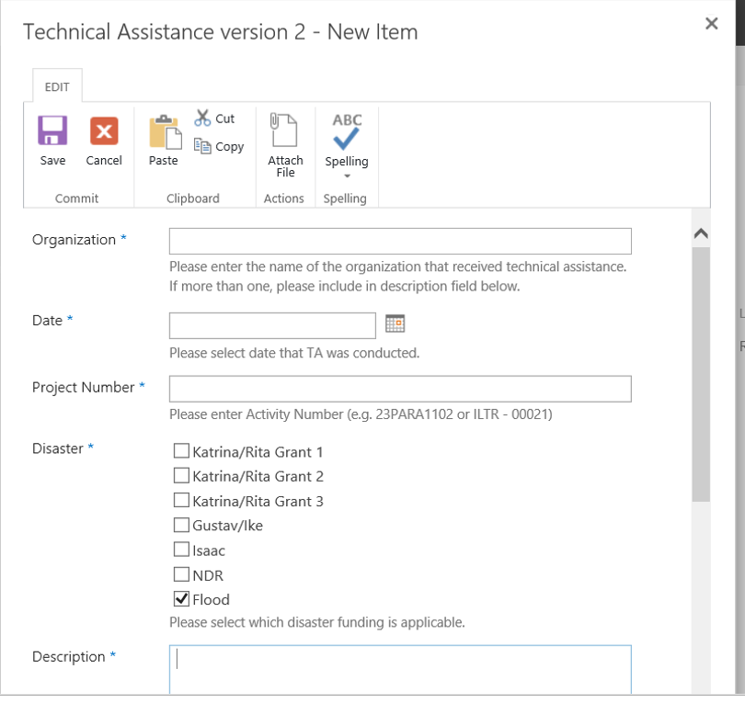
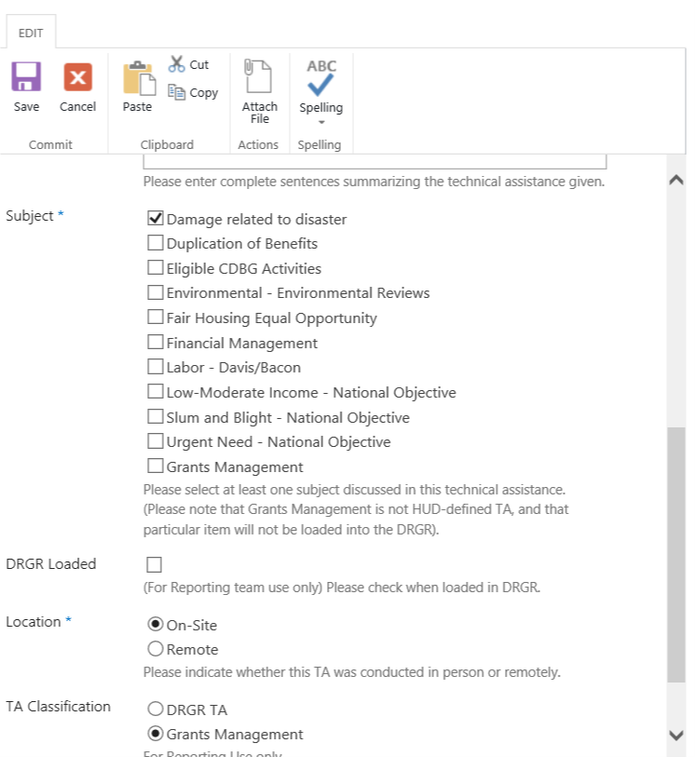
Example of TA Entry Screen on SharePoint

Slide 9
Questions???

